Slide 1
The Columbian Women: A Historical Sketch
Eden Orelove

Slide 2
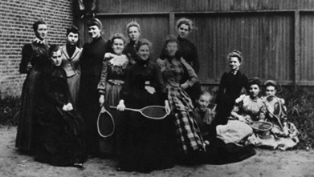
Introduction
The “Original Thirteen”
Oldest and largest women’s organization at GW
In existence since 1894 – 121 years!
Started to raise scholarship funds for Mary Chapin, a student whose father died in a fire at Ford’s Theater
Major aims: the advancement of women at the University and the promotion of interests of their alma mater

Slide 3
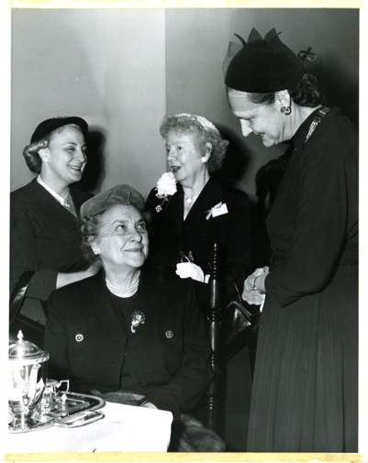
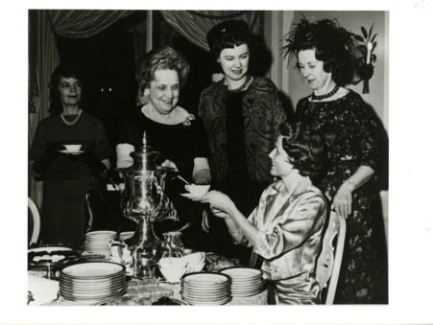
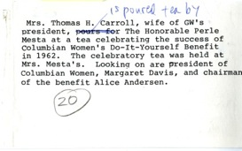
Tea celebrating the success of Columbian Women’s “Do-It-Yourself” Benefit in 1962
Mrs. Stanley Reed, wife of the Supreme Court Justice, pours at a Columbian Women Tea held at Lisner Auditorium (October 1953)

Slide 4
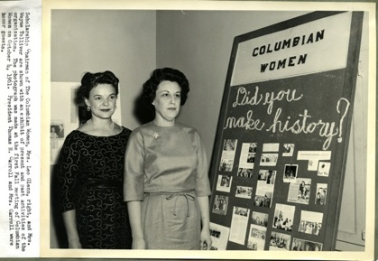
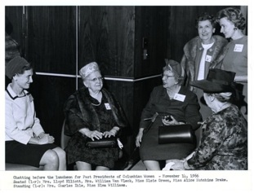
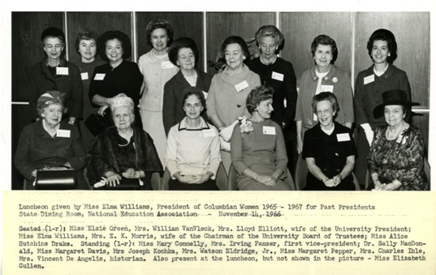
Luncheon for Past Presidents (1966)
Scholarship Chairman of The Columbian Women, Mrs. Leo Glenn, right, and Mrs. Wayne Tolliver are shown with an exhibit of present and past activities of the organization. The photograph was made at the first fall meeting of Columbian Women on October 4, 1961.

Slide 5
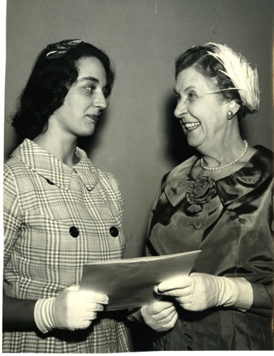
“Miss Cynthia Rhodes was the first to receive Columbian Women’s new award to that graduating senior woman who in her student life most nearly demonstrates the purpose of Columbian Women – a concern for scholarship, fellowship, and the development of the University.
At the Awards Tea in Lisner Auditorium lounge on June 5, 1961, with Mrs. Charles W. Ihle, retiring President of Columbian Women making the presentation.” -caption on back

Slide 6
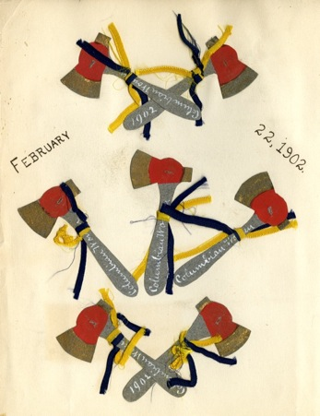
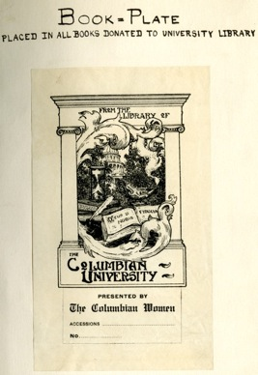
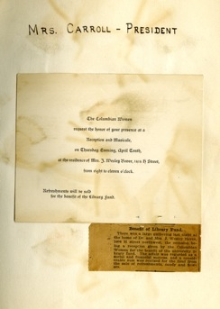
Fundraising for Library (1902)

Slide 7
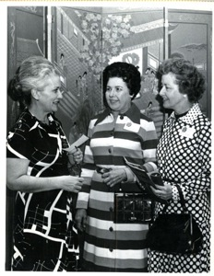
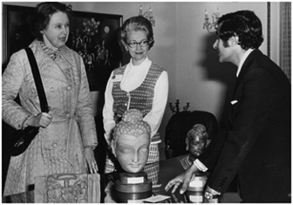
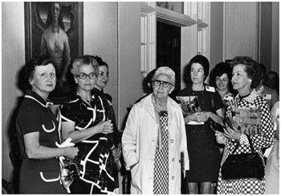
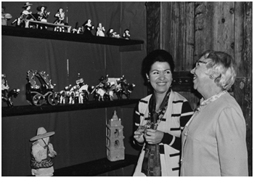
Tour of Embassies April 27, 1974
Embassy of Pakistan
Embassy of Venezuela
Embassy of Chile

Slide 8
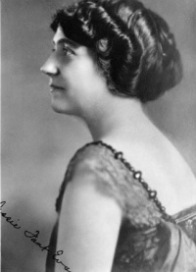
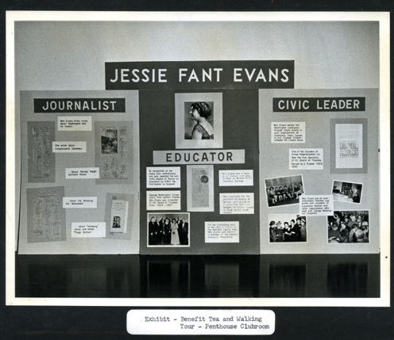
Jesse Fant Evans (1890-1966)
Honorary member of Columbian Women
Prominent in Washington professional and citizens’ activities
Vice President of the 20th Century Club
Her feature column was printed in The Washington Star

Slide 9
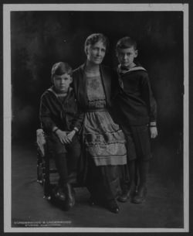
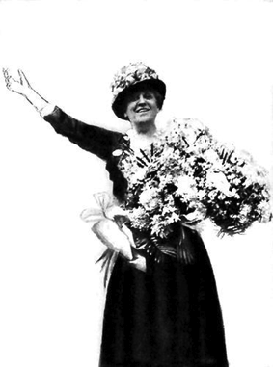
Anna Kelton Wiley (1877-1964)
President of Columbian Women from 1927-29
Arrested and jailed in 1917 for “obstructing traffic” on Pennsylvania Avenue after picketing the White House along with 217 suffragettes
Chairwoman of the National Women’s Party and edited its publication, Equal Rights
President of the American Pure Food League
Studio portrait of Anna Kelton Wiley, with sons John Preston Wiley and Harvey W. Wiley, Jr.

Slide 10
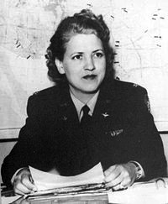
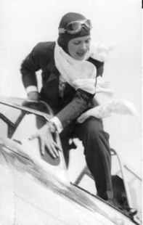
Jacqueline Cochran (1906-1980)
A pioneer in the field of American aviation, considered to be one of the most gifted racing pilots of her generation
An important contributor to the formation of the wartime Women’s Auxiliary Army Corps (WAAC) and Women Airforce Service Pilots (WASP)
GW Trustee
c. 1943
1938 Bendix Race

Slide 11
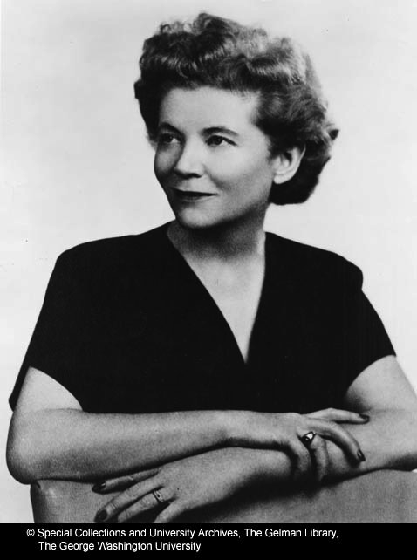
Eva B. Adams (1908-1991)
Former director of the U.S. Mint, appointed by John F. Kennedy in 1961
Held position for eight years
Aide to three U.S. senators Commented that during her years in Washington, a woman administrative assistant was expected to “Dress like a queen. Act like a lady. Think like a man. Work like a dog.”
Received the Distinguished Nevadan award (1966)
Named one of Nevada’s “Outstanding Women of the Century” (1973)
Inducted into the Nevada Women’s Fund Hall of Fame (1985)

Slide 12
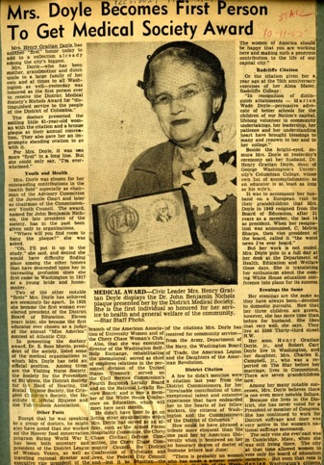
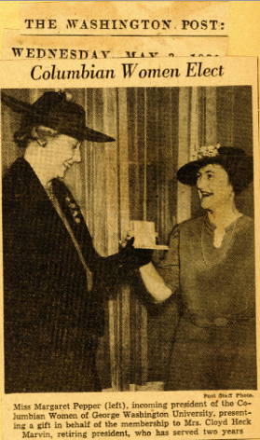
Dorothy Betts Marvin
Marion Wade Doyle
President of Columbian Women
President of the Washington Club and the National League of American Pen-women
Donated over one million dollars to build the Marvin Center
The first woman president of the District of Columbia Board of Education

Slide 13
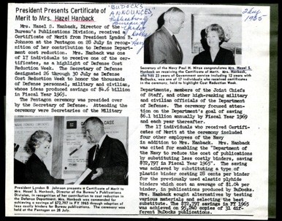
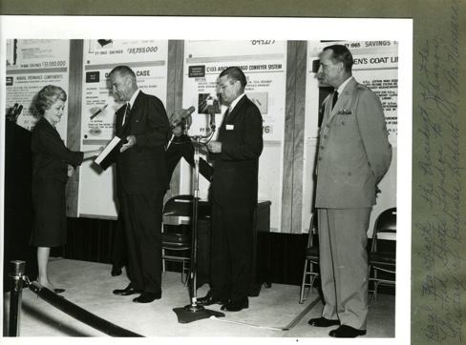
Hazel Smallwood Hanback (1918-2008)
GW Board of Trustees member, 1979-1996
President of Columbian Women
Member of the General Alumni Association’s Governing Board
President and board chairman of the University Club
President of the West End Citizen’s Association
GW Alumni Service Award recipient (1972)
Shown receiving a Certificate of Merit from President Lyndon B. Johnson at the Pentagon in recognition of her contribution to Defense Department cost reductions (1965)

Slide 14
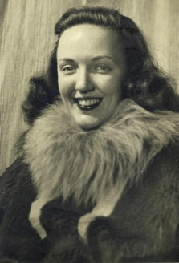
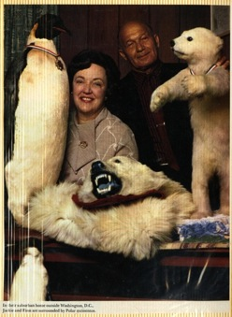
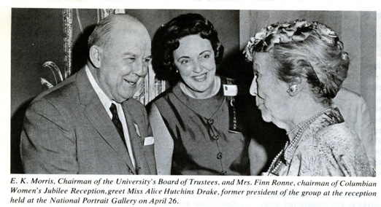
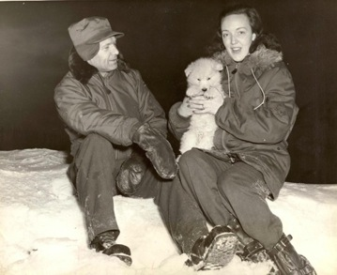
Jackie Ronne (1919-2009)
Explorer of Antarctica and the first woman in the world to be a working member of an Antarctic expedition
GW Alum

Slide 15
Other Notable Members
U.S. District Court Judge Sarah T. Hughes, who administered the oath of office to Lyndon Johnson following President John F. Kennedy’s 1963 assassination
Mabel Nelson Thurston, first and only woman student admitted to the University’s Columbian College in 1888, namesake of Thurston Hall Dormitory
Frances Parkinson Keyes, novelist
Helen Nicolay, biographer of Abraham Lincoln
Mary Roberts Rinehart, mystery writer
Julia Marlowe, actress
Dr. Helen Marie Dyer, biochemist
Katharine Graham, Washington Post publisher
Marguerite Rawalt, attorney and nationally known women’s rights leader
Dr. Elizabeth Webb Wilson, the first woman to be seated as a delegate at the International Actuarial Congress

Slide 16
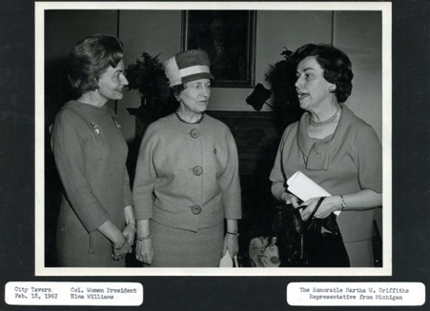
Speakers and Honorees (to name a few)
Congresswoman Martha Griffiths, held a judgeship before election to the U.S. Congress (served seven terms), in 1962 was selected Woman of the Year by the Detroit Soroptimist Club
Mrs. Truman was an honored guest at the opening tea of the Columbian Women at the University Women’s Club and she entertained Columbian Women members at a White House tea
Mrs. Barkley, wife of the Vice President, was a guest of honor at a luncheon (1951)

Slide 17
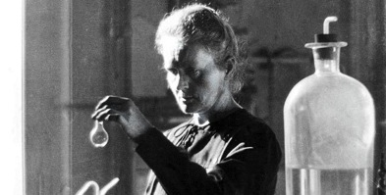
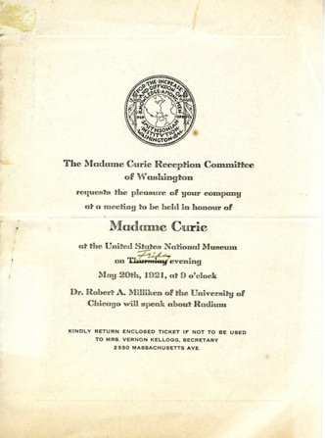
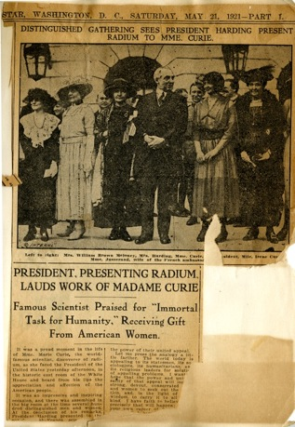
Madame Curie’s visit to D.C. (1921)
Contributed to the purchase of a gram of radium for Madame Curie

Slide 18
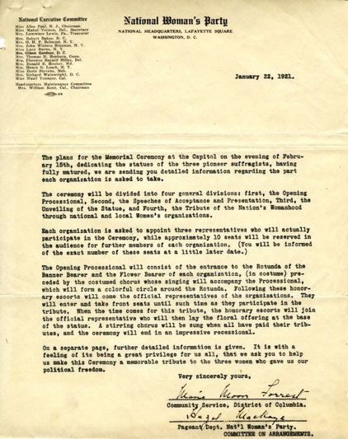
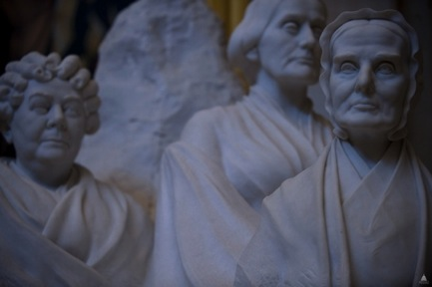
Suffrage Memorial
Columbian Women President Elizabeth Peet, who later became dean of Gallaudet College, represented the group at suffrage memorial ceremonies at the Capitol (February 15, 1921)
600 women from 30 states filled the rotunda for the unveiling and presentation to Congress of the statue of three pioneers of the women’s movement: Susan B. Anthony, Elizabeth Dady Stanton and Lucretia Mott

Slide 19
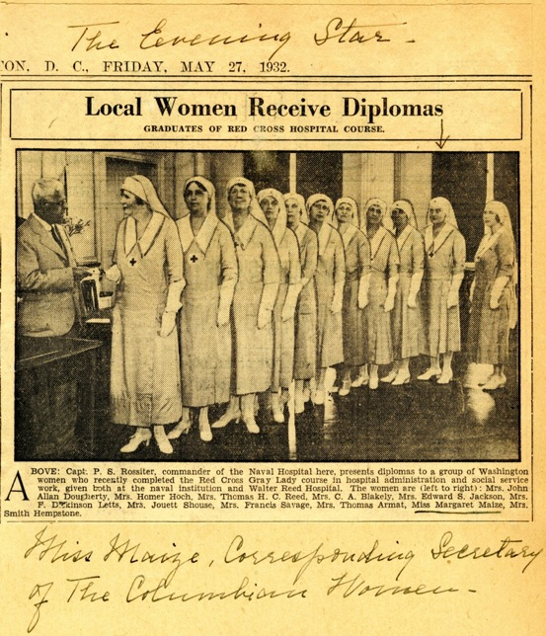
“From the beginning, Columbian Women was concerned about the woman who would have to drop out of college because of her father’s death, and throughout the years they have been dedicated to the advancement of women through higher education – the main process by which women will achieve equality.”
-Dr. Ruth Osborn (former Columbian Women President)

